Slide 1
Sequences and Series
Shreyas M
B.Tech in ECE PES University Bangalore

Slide 2
Chapter map
Section | Topic
1 | Introduction and Basics
2 | Arithmetic Progression
3 | Properties of AP and Arithmetic mean
4 | Geometric Progression
5 | Properties of GP and Geometric Mean
6 | Sigma and Pi functions
7 | Harmonic Progression and Harmonic Mean
8 | Supplement – Expansions of some common function

Slide 3
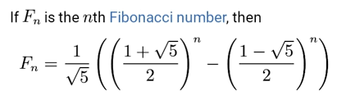
1 Introduction and basics
In engineering, the algebra of patterns, sequences and series have strong applications. When it comes to approximations, the algebraic expansion of some common functions (as shown in the supplement section). These expansions are called Taylor Series Expansions.
Basics : A sequence is an array of numbers with well defined similar property. A sum obtained by adding each element of a sequence is called a series.
Example : Fibonacci sequence
1,1,2,3,5,8,13,21,34,55, …………….

Slide 4
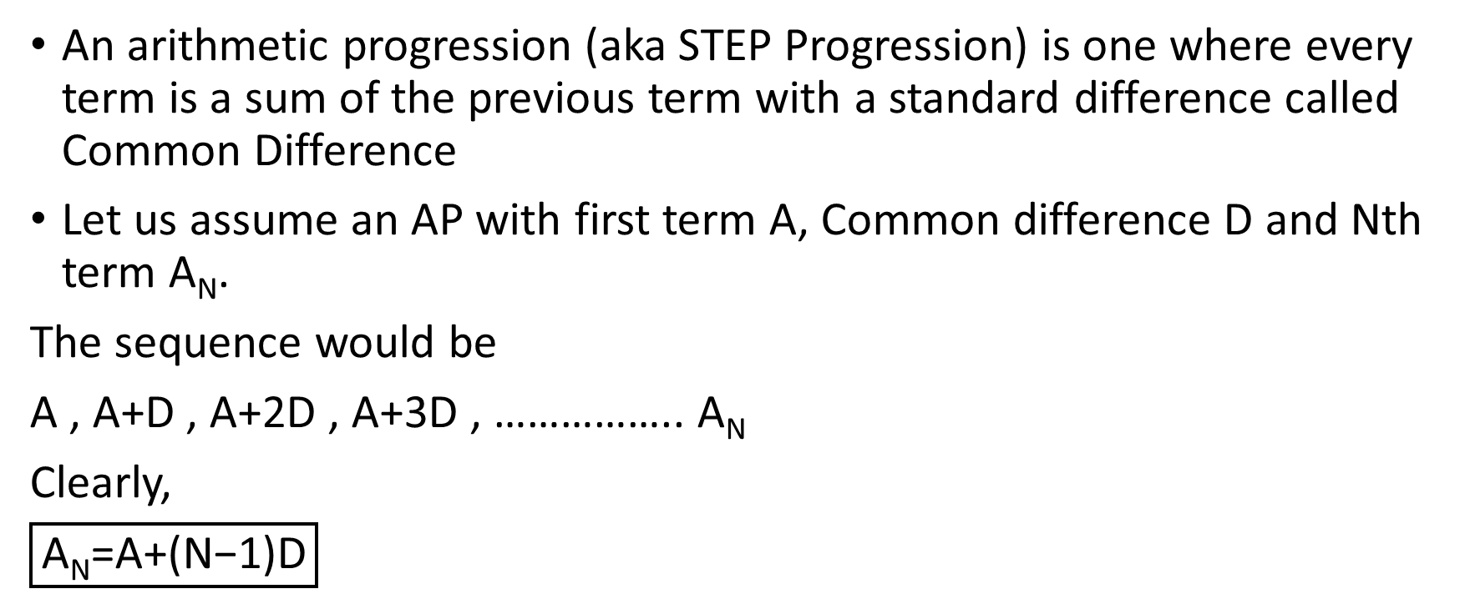
2 Arithmetic progression
An arithmetic progression (aka STEP Progression) is one where every term is a sum of the previous term with a standard difference called Common Difference
Let us assume an AP with first term A, Common difference D and Nth term A_{N}.
The sequence would be
A , A+D , A+2D , A+3D , …………….. A_{N}
Clearly,
$$\boxed{\text{A}\text{N}\text{=}\text{A}\text{+(}\text{N}\text{−1)}\text{D}}$$

Slide 5
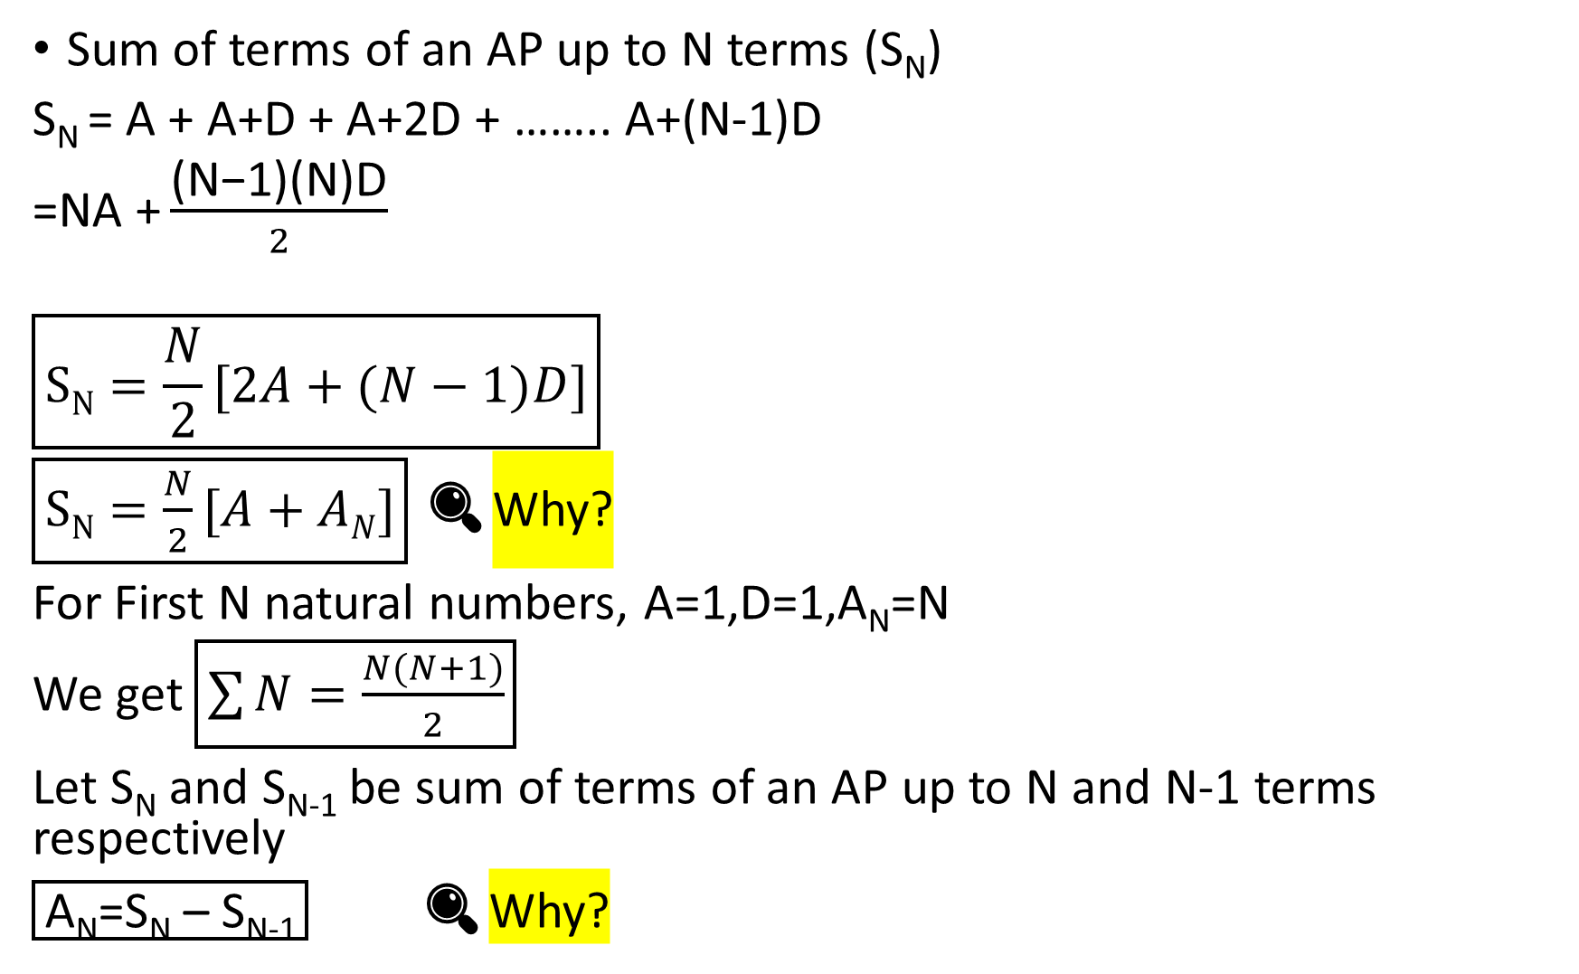
Sum of terms of an AP up to N terms (S_{N})
S_{N} = A + A+D + A+2D + …….. A+(N-1)D
=$\text{NA}\text{ +}\frac{\text{(}\text{N}\text{−1)(}\text{N}\text{)}\text{D}}{2}$
$$\boxed{SN=\frac{N}{2}[2A+(N−1)D]}$$
$\boxed{SN=\frac{N}{2}[A+AN]}$ 🔍Why?
For First N natural numbers, A=1,D=1,A_{N}=N
We get $\boxed{\sum{N}=\frac{N(N+1)}{2}}$
Let S_{N} and S_{N-1} be sum of terms of an AP up to N and N-1 terms respectively
$\boxed{\text{A}\text{N}\text{=}\text{SN}\text{ – }\text{SN}\text{−1}}$ 🔍Why?

Slide 6
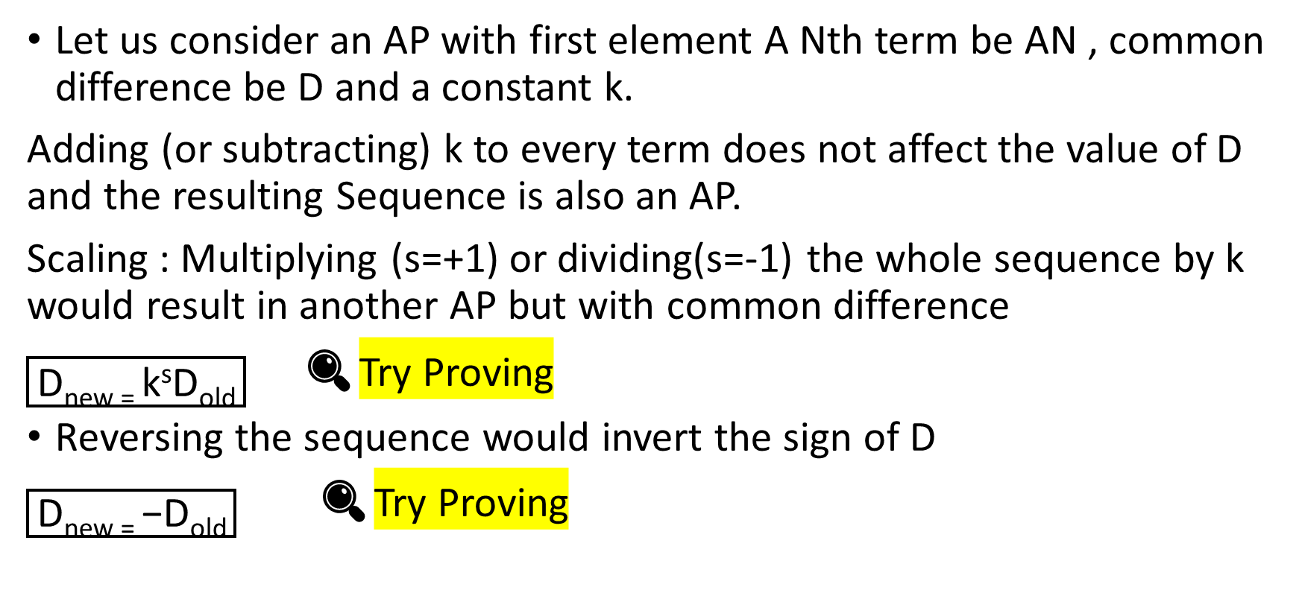
3 Properties of AP and arithmetic mean
Let us consider an AP with first element A Nth term be AN , common difference be D and a constant k.
Adding (or subtracting) k to every term does not affect the value of D and the resulting Sequence is also an AP.
Scaling : Multiplying (s=+1) or dividing(s=-1) the whole sequence by k would result in another AP but with common difference
$\boxed{\text{D}\text{new}\text{ = }\text{k}\text{s}\text{D}\text{old}}$ 🔍Try Proving
Reversing the sequence would invert the sign of D
$\boxed{\text{D}\text{new}\text{ = }\text{−}\text{D}\text{old}}$🔍Try Proving

Slide 7
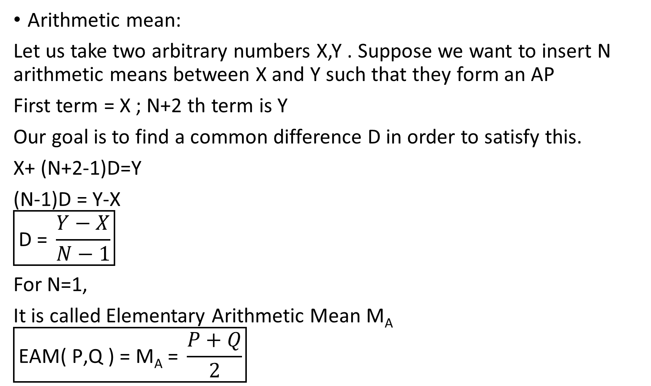
Arithmetic mean:
Let us take two arbitrary numbers X,Y . Suppose we want to insert N arithmetic means between X and Y such that they form an AP
First term = X ; N+2 th term is Y
Our goal is to find a common difference D in order to satisfy this.
X+ (N+2-1)D=Y
(N-1)D = Y-X
$$\boxed{\text{D}\text{ = }\frac{Y−X}{N−1}}$$
For N=1,
It is called Elementary Arithmetic Mean M_{A}
$$\boxed{\text{EAM}\text{( }\text{P}\text{,}\text{Q}\text{ )}\text{ = }\text{MA}\text{ = }\frac{P+Q}{2}}$$

Slide 8
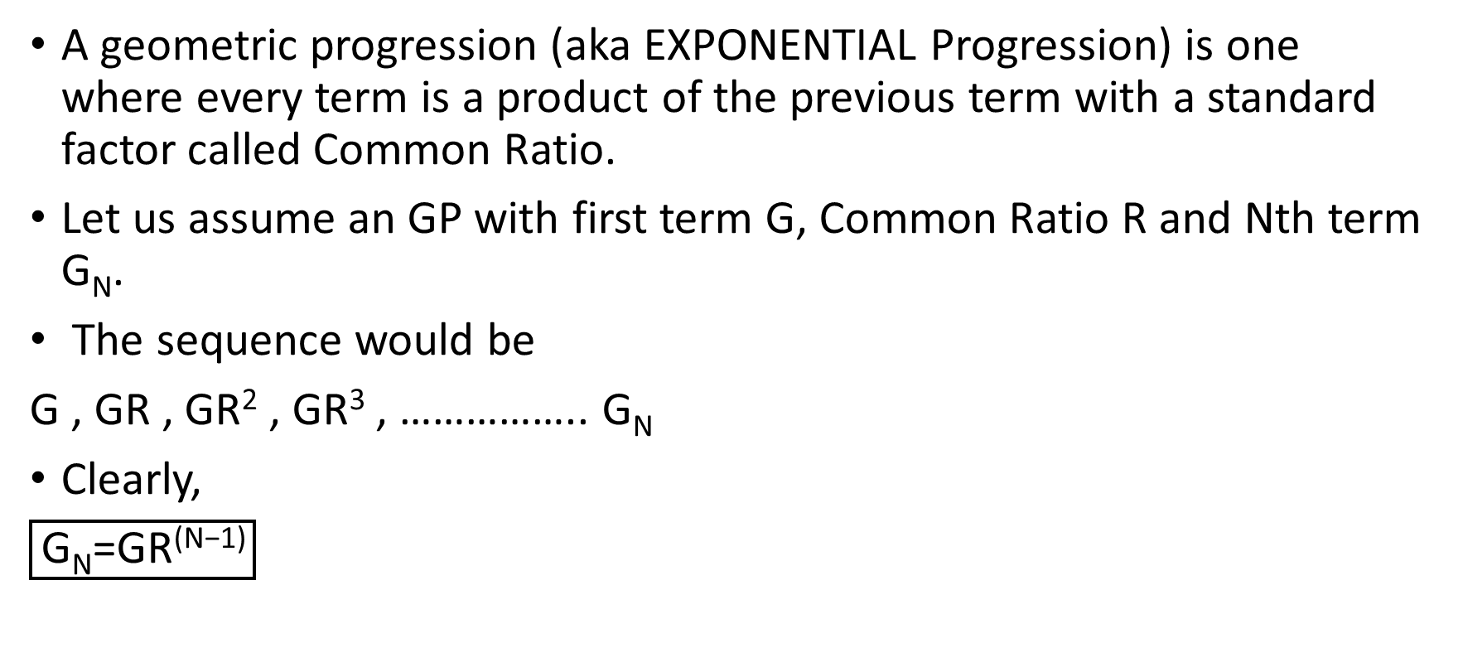
4 Geometric progression
A geometric progression (aka EXPONENTIAL Progression) is one where every term is a product of the previous term with a standard factor called Common Ratio.
Let us assume an GP with first term G, Common Ratio R and Nth term G_{N}.
The sequence would be
G , GR , GR² , GR³ , …………….. G_{N}
Clearly,
$$\boxed{\text{G}\text{N}\text{=}\text{GR}\text{(}\text{N}\text{−1)}}$$

Slide 9

Sum up to N terms of GP
S_{N}=$\frac{G(RN−1)}{(R−1)}$ if |R|>1
S_{N}= $\frac{G(1−RN)}{(1−R)}$ if |R|<1
Product up to N terms of GP
P_{N} = G X GR X GR² X GR³…………… GR^{N-1}
P_{N}=$G^{N}R^{\frac{N(N−1)}{2}}$
Also
$$\boxed{\text{G}\text{N}\text{=}\frac{P_{n}}{P_{(n−1)}}}$$

Slide 10
5 Properties of GP and Geometric Mean
Let us consider an GP with first element A Nth term be G_{N} , common ratio be R and a constant k.
Multiplying or dividing the whole sequence by k , the sequence would continue to be a geometric progression and there is no alteration in the Common ratio.
Let us take two arbitrary numbers X,Y . Suppose we want to insert N geometric means between X and Y such that they form an GP
First term = X ; N+2 th term is Y
Our goal is to find a common ratio R in order to satisfy this.

Slide 11
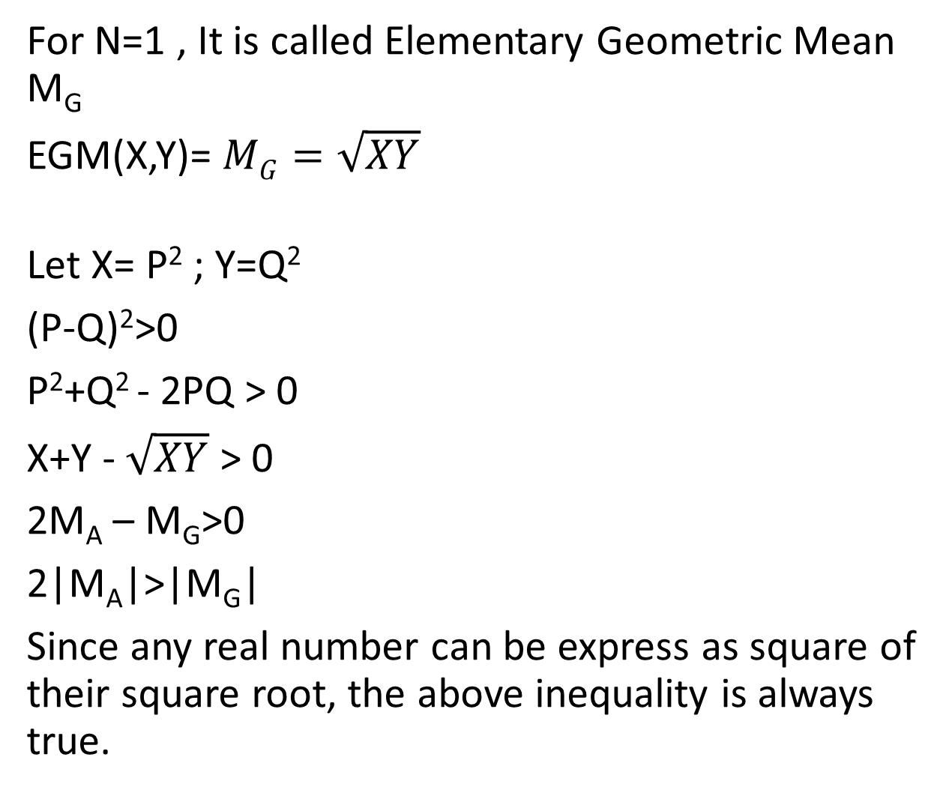
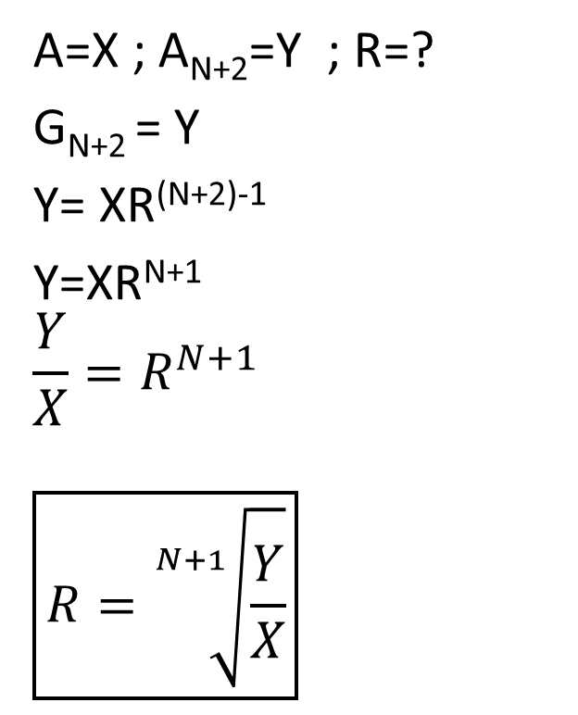

A=X ; A_{N+2}=Y ; R=?
G_{N+2} = Y
Y= XR^{(N+2)-1}
Y=XR^{N+1}
$$\frac{Y}{X}=R^{N+1}$$
$$\boxed{R=\sqrt[N+1]{\frac{Y}{X}}}$$
For N=1 , It is called Elementary Geometric Mean M_{G}
EGM(X,Y)= $MG=\sqrt{XY}$
Let X= P² ; Y=Q²
(P-Q)²>0
P²+Q² - 2PQ > 0
X+Y - $\sqrt{XY}$ > 0
2M_{A} – M_{G}>0
2|M_{A}|>|M_{G}|
Since any real number can be express as square of their square root, the above inequality is always true.
$$\sqrt{XY}$$
🔍Explain why Geometric mean of two numbers of opposite sign is not defined.

Slide 12
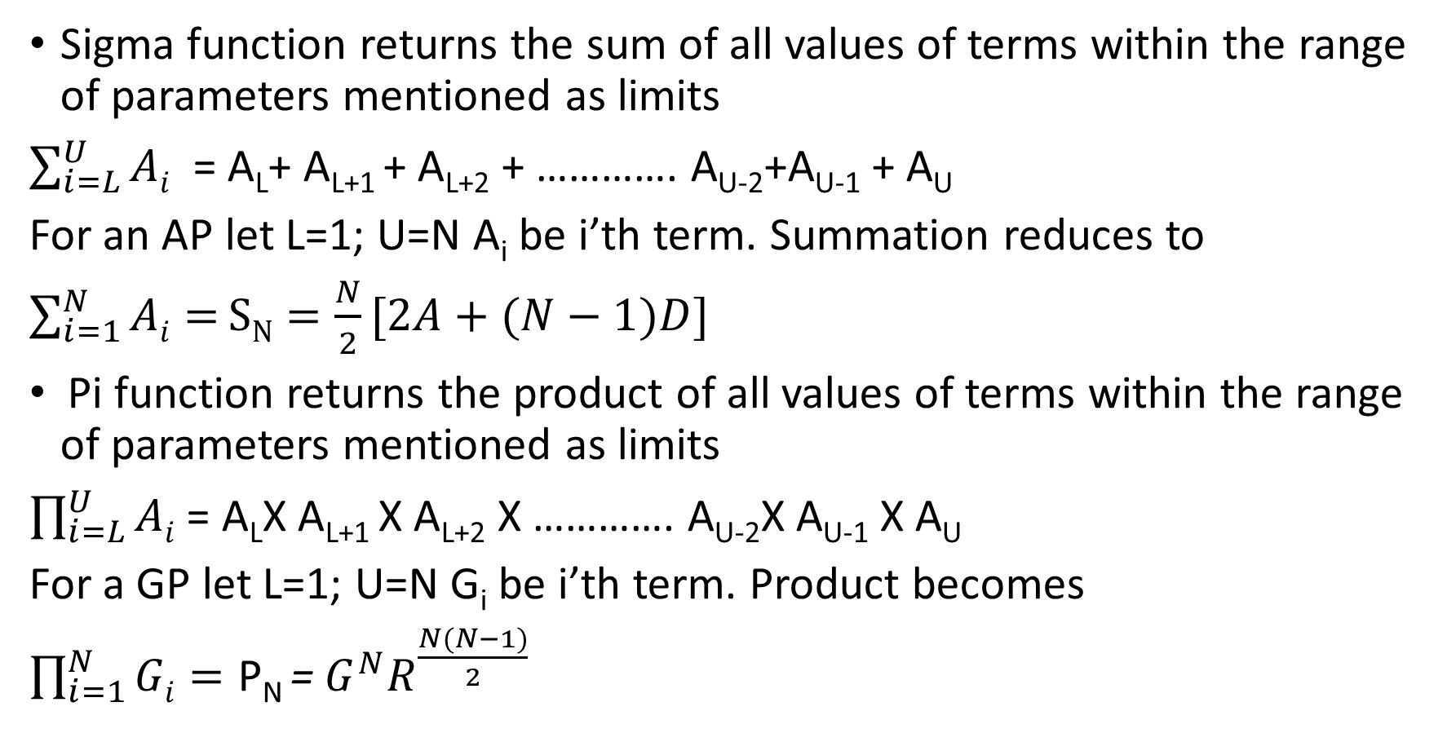
6 Sigma and Pi functions
Sigma function returns the sum of all values of terms within the range of parameters mentioned as limits
$\sum_{i=L}^{U}{Ai}$ = A_{L}+ A_{L+1} + A_{L+2} + …………. A_{U-2}+A_{U-1} + A_{U}
For an AP let L=1; U=N A_{i} be i’th term. Summation reduces to
$\sum_{i=1}^{N}{Ai=}SN=\frac{N}{2}[2A+(N−1)D]$
Pi function returns the product of all values of terms within the range of parameters mentioned as limits
$\prod_{i=L}^{U}{Ai}$ = A_{L}X A_{L+1} X A_{L+2} X …………. A_{U-2}X A_{U-1} X A_{U}
For a GP let L=1; U=N G_{i} be i’th term. Product becomes
$\prod_{i=1}^{N}{Gi}=\text{P}\text{N} \text{= }G^{N}R^{\frac{N(N−1)}{2}}$

Slide 13
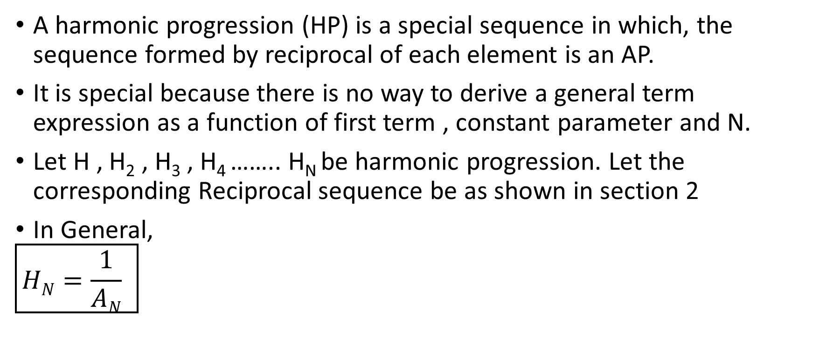
7 Harmonic progression
A harmonic progression (HP) is a special sequence in which, the sequence formed by reciprocal of each element is an AP.
It is special because there is no way to derive a general term expression as a function of first term , constant parameter and N.
Let H , H₂ , H₃ , H₄ …….. H_{N} be harmonic progression. Let the corresponding Reciprocal sequence be as shown in section 2
In General,
$$\boxed{HN=\frac{1}{AN} }$$

Slide 14
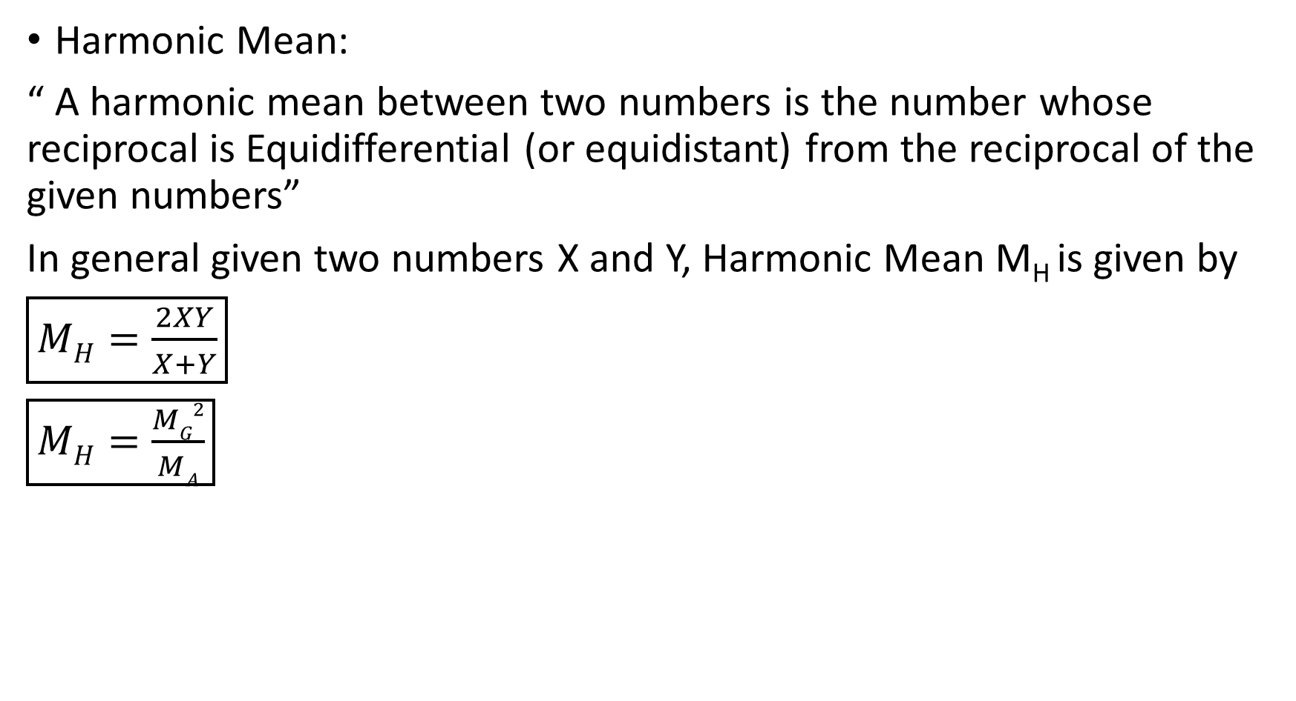
Harmonic Mean:
“ A harmonic mean between two numbers is the number whose reciprocal is Equidifferential (or equidistant) from the reciprocal of the given numbers”
In general given two numbers X and Y, Harmonic Mean M_{H} is given by
$\boxed{MH=\frac{2XY}{X+Y}}$
$\boxed{MH=\frac{MG2}{MA}}$

Slide 15
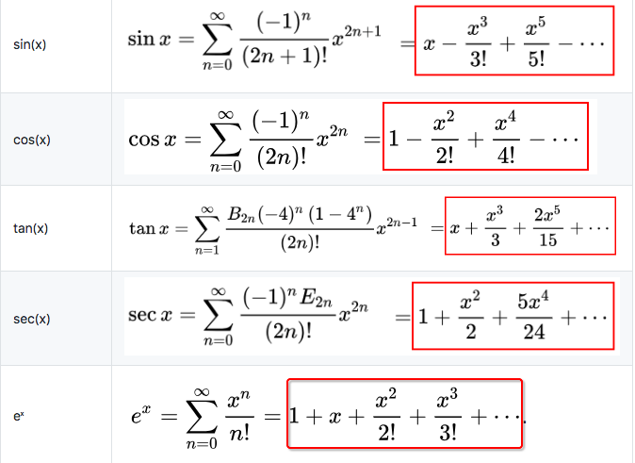
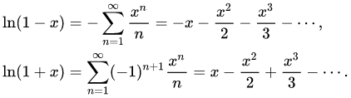
8 Expansions of some common functions
Some functions can be expanded to make some transformations or computation easier. Such expansions are called MacClaurin’s Expansion. Some common expansions are shown below

Slide 16
Thank you
Shreyas M
B.Tech in ECE PES University Bangalore

